Slide 1
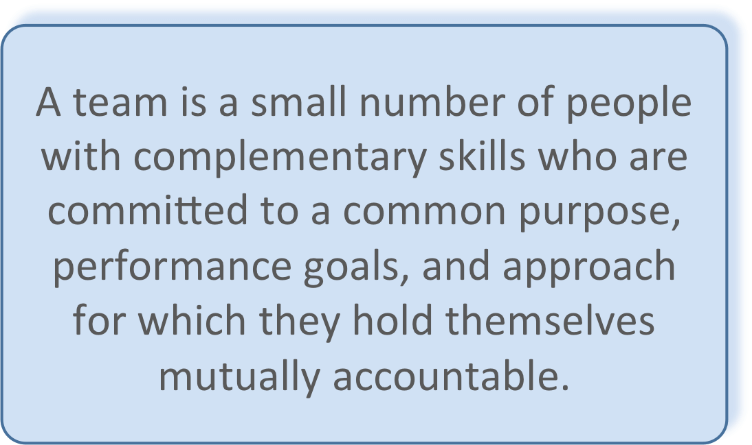
Real Teams

Slide 2
Why DevOps?
Get to value quicker
Increase collaboration - bust silos
Focus on real work
Embrace change
Innovate
Notes:
Demonstrate value as quickly as possible - demonstrate this will real users not proxies
Get to know your fellow colleagues and have them join your team - if not permanently then at least at your agile ceremonies - share with others inside and outside your world
Automate everywhere you can - robots are much better than humans at repetitive tasks let them do that and focus on real work that delivers real value to our users
Business does not sit idle why do we protect the status quo - change is the new norm
Constantly learn, constantly look for ways to improve and challenge the status quo

